Slide 1
Banking Word Embedding
By: Aritro Biswas
PSID: 45102136

Slide 2
What are Word Vectors?
Represention a word with a very high-dimensional sparse vector, where each dimension reflects a context in which the word occurred in the corpus. A context could be another word that appeared in its proximity (pre-defined).
word vectors put words to a vector space, where similar words cluster together and different words repel from one another.

Slide 3
What are Word Embedding?
Represention of a word with a low-dimensional vector (e.g. 100,200 dimensions). This vector is dense, and is computationally inexpensive compared to word vectors owing to its lower dimension.

Slide 4
Learning these Low Dimension Word Embeddings
These can be done in two ways :
Matrix Factorisation :
In this method the word-content matrix built from the corpus is factorised
using Single Value Decompostion (SVD) to obtain a term – dimension matrix
which is the word embedding framework that is required.
Neural Networks:
In this method a neural network is trained on the word and its
context(window predefined). Once the neural network has been trained,
the learned linear transformation in the hidden layer is taken as the word
embedding.

Slide 5
Models Available
LSA (Latent Semantic Analysis)
Word2Vec (Skip-gram and Continuous Bag of Words)
Glove (Global Vectors)
Literature (Name) Words Embedding Framework from Glove model outperforms that from other models in Word Analogy, Word Similarity and Named Entity Recognition tasks on respective benchmark datasets.

Slide 6
Obtaining text for corpus.
List of finance books
The New Paradigm for Financial Markets- George Soros
Lords of Finance- Liaquat Ahamed
The Intelligent Investor- Benjamin Graham, Jason Zweig, Warren E. Buffett.
Investment Banking- Joshua Rosenbaum, Joshua Pearl, Joseph R. Perella
Accounting: Text and Cases-Anthony,Hawkins,Merchant
Investments- Bodie, Kane,Marcus
Financial Managemment: Theory and Practice : Brigham, Ehrhardt
Principles of Corporate Finance-Brealy, Myers, Allen
Financial Accounting and Its Environment
Introduction to Structured Finance- Fabozzi, Davis, Chowdhury
Accounting for managers- William Webster
The Handbook of Financial Instruments- Frank J. Fabozzi

Slide 7
Barbarians at the Gate
Common Sense on Mutual Funds
Extraordinary Popular Delusions and the Madness of Crowds
Fundamentals of Corporate Finance
Guide to Financial Management
International corporate finance
Investment Leadership and Portfolio Management
Investment Management
Lessons in Corporate Finance
Liar's Poker
Mastering Market Timing
Mergers and acquisitions in banking and finance
Random Walk Down Wall Street

Slide 8
Reducing the Risk of Black Swans
Strategy, Value and Risk
The Alchemy of Finance
The Little Book of Behavioral Investing
Venture Capital and the Finance of Innovation

Slide 9
Creating plain text corpus
Modules Used-
word_tokenize , sent_tokenize from nltk.tokenize
Input Format:
One continuous text (.txt format) obtained by combining different discrete chunks of texts.
output format:
list of lists (as required by word embedding training models)
Each sentence is list of words in the sentence.
corpus is list of these lists (sentences).

Slide 10
Pre-processing corpus
Steps:
Removal of Named Entities
Removal of non-english words
Lower-casing
Removing stop-words
Removing numbers and punctuations
Removing null statements.

Slide 11
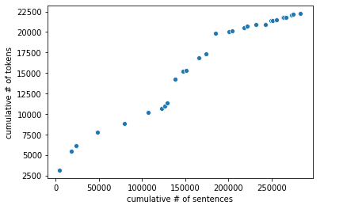
Corpus Adequacy Check
The number of unique tokens appear to be saturating.

Slide 12
Checking the frequency of occurrence of a few typical words
Commonly used in financial institutions.
WORD | Term-Frequency in Corpus | Document - Frequency
Credit | 4918 | 4088
Debit | 151 | 137
Card | 329 | 290
Loan | 2521 | 2167
Mortgage | 1453 | 1255
Savings | 836 | 768
Account | 2196 | 1995

Slide 13
Overview of the corpus
Before Pre-processing
Total number of sentences: 283,307
Total number of words: 5,031,475
After Pre-processing
Total number of sentences: 266,959
Total number of words: 2,151,631
}
Total number of unique words: 22,242

Slide 14
Introduction of Glove model
GloVe is a word vector technique it is an abbreviation which stands for Global Vectors. The advantage of GloVe is that, unlike Word2vec, GloVe does not rely just on local statistics (local context information of words), but incorporates global statistics (word co-occurrence) to obtain word vectors.
It efficiently leverages statistical information by training only on the non-zero elements in a word co-occurrence matrix, rather than on the entire sparse matrix or on individual context windows in a large corpus.
Co-occurrence matrix
A co-occurrence matrix will have unique words in rows and columns . The purpose of this matrix is to present the number of times each word appears in the same context as each word in columns.

Slide 15
Construction of Word co-occurrence matrix
CORPUS : Roses are red . Sky is blue
WINDOW : 2
Unique words : Roses,are,red,Sky,is,Blue
Now a term-term matrix is created with all the values initialized to “0”
Focus ↓ \Context → | Roses | are | red | Sky | is | Blue
Roses | 0 | 0 | 0 | 0 | 0 | 0
are | 0 | 0 | 0 | 0 | 0 | 0
red | 0 | 0 | 0 | 0 | 0 | 0
Sky | 0 | 0 | 0 | 0 | 0 | 0
is | 0 | 0 | 0 | 0 | 0 | 0
Blue | 0 | 0 | 0 | 0 | 0 | 0

Slide 16
1st iteration
Focus Word: Roses
Context Word:
Focus ↓ \Context → | Roses | are | red | Sky | is | Blue
Roses | 1 | 1 | 1 | 0 | 0 | 0
Since every focus word appears in its own context, all the diagonal elements are incremented
2nd iteration
Focus Word: are
Context Word:
{
red -> word after Roses
Roses -> word before Roses
Focus ↓ \Context → | Roses | are | red | Sky | is | Blue
Roses | 1 | 1 | 1 | 0 | 0 | 0
are | 1 | 1 | 1 | 0 | 0 | 0

Slide 17
3rd iteration
Focus Word: red
Context Word:
{
No word after Roses
Roses , are -> words before Roses
Focus ↓ \Context → | Roses | are | red | Sky | is | Blue
Roses | 1 | 1 | 1 | 0 | 0 | 0
are | 1 | 1 | 1 | 0 | 0 | 0
red | 1 | 1 | 1 | 0 | 0 | 0
4th iteration
Focus Word: Sky
Context Word:
{
is, blue -> words after Sky
No word before Sky
Focus ↓ \Context → | Roses | are | red | Sky | is | Blue
Roses | 1 | 1 | 1 | 0 | 0 | 0
are | 1 | 1 | 1 | 0 | 0 | 0
red | 1 | 1 | 1 | 0 | 0 | 0
Sky | 0 | 0 | 0 | 1 | 1 | 1

Slide 18
Thus following this procedure till the 6th iterartion (as there are six unique words in the corpus)
we obtain the required word co-occurrence matrix
Focus ↓ \Context → | Roses | are | red | Sky | is | Blue
Roses | 1 | 1 | 1 | 0 | 0 | 0
are | 1 | 1 | 1 | 0 | 0 | 0
red | 1 | 1 | 1 | 0 | 0 | 0
Sky | 0 | 0 | 0 | 1 | 1 | 1
is | 0 | 0 | 0 | 1 | 1 | 1
Blue | 0 | 0 | 0 | 1 | 1 | 1

Slide 19
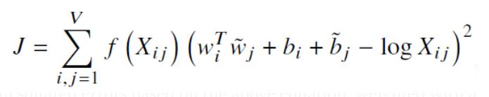
Loss function of Glove model
w_{i} = word-embedding of i^{th} word in row of co-occurrence matrix (focus word)
ῶ _{j} = word-embedding of j^{th} word in column of co-occurrence matrix (context word)
b_{i} = Bias term for i^{th} focus word
b_{j} = Bias term for j^{th} context word.
X_{ij} = (ij)^{th} element of the co-occurrence matrix.
f(X_{ij} ) = min (1, (X_{ij} / X_{ij} _max) ^{3/4} ) a.k.a weighing function
v = size of the vocabulary or simply number of unique words in the corpus

Slide 20
The word embeddings are obtained by minimising the loss function through gradient descent.
Since, the embeddings are a solution obtained through gradient descent they will always be slightly different each time we obtain them for the same set of hyper-parameters as every-time the solution we obtain will be sub-optimal.

Slide 21
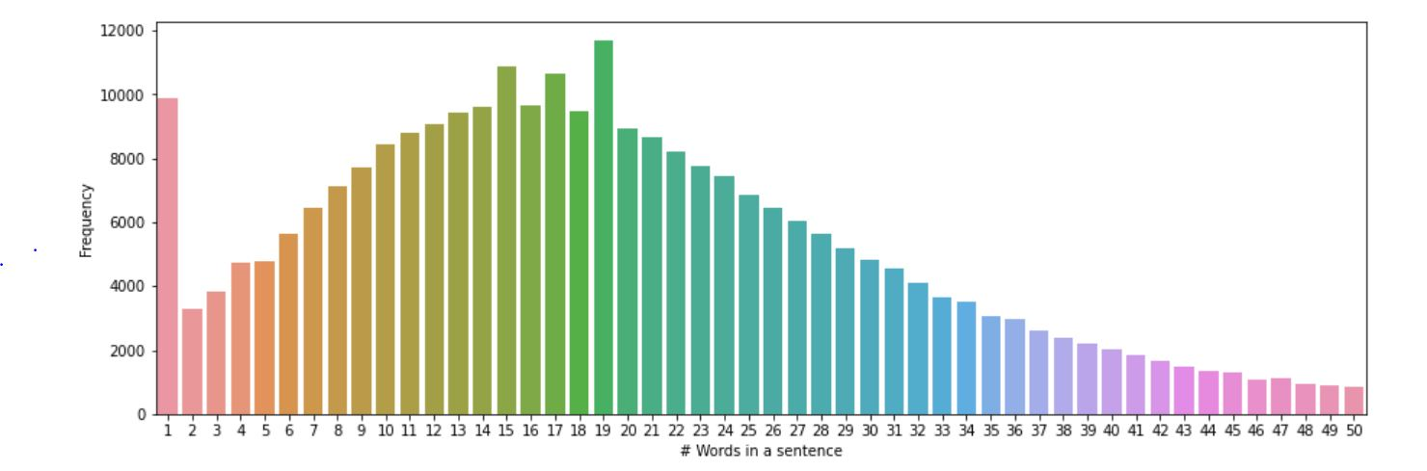
Training the glove model
Feeding the corpus to the glove model
In order to form the co-occurrence matrix we have to specify the window.
Selection of window size
20th percentile of number of words = 10
So let us consider windows=1,2,3,4 (as {2 X 4 + 1 = 9 < 10})

Slide 22
Number of Dimensions:
Standard number of dimensions in pre-trained vectors are: 50,100,200,300.
According to the literature (provide the name) for semantic task, there is a diminishing performace when the number of dimensions increases above 200.
Let us consider the Number of dimensions =30,50,80,100
Hyper-parameter tuning
Let us consider the following hyperparameters:
Window=[1,2,3,4,5]
Number of dimensions=[30,50,80,100]
Learning rate = [0.01,0.02,0.05,0.1]
Number of epochs=[5,10,15,20]

Slide 23
Objective functions:
Cosine similarity between “credit” and “debit” based on the vectors obtained from the glove model.
Let us take 5 replications of cosine similarities for each combinations of hyper-parameters
NOTE1: We are considering replications as each time the word embeddings will be slightly different as the solution is obtained through gradient descent.
NOTE2: We consider the similarity between “credit” and “debit” because their prominent paradigmatic relation, which means the words are basically interchangeable without changing the context.
The most optimum set of result should satisfy the following codition:
To ensure accuracy of solution : MAX(average(cosine_similarity(“credit”,”debit”)))
To ensure robustness of solution : MIN(variance(cosine_similarity(“credit”,”debit”)))

Slide 24
It was found that the set of hyper-parameters which gave optimum result were:
Window=3
Number of dimensions=100
Learning rate = 0.01
Number of epochs=10
Thus, this combination is used to obtain the final word embeddings framework.

Slide 25
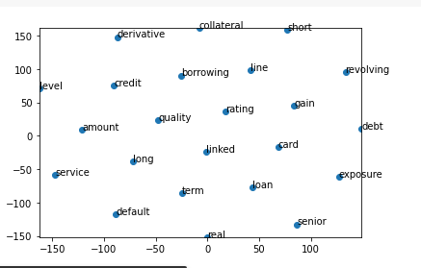
2D projection of top 0.1 %-tile similar words to “CARD” using TSNE

Slide 26
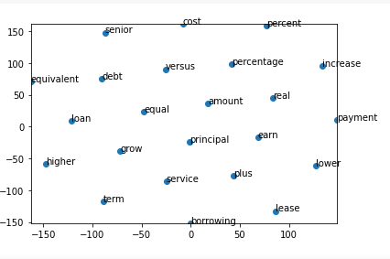
2D projection of top 0.1 %-tile similar words to “Loan” using TSNE

Slide 27
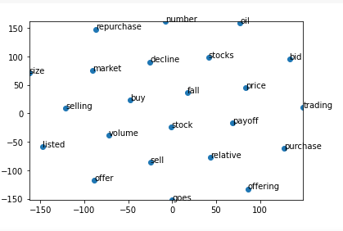
2D projection of top 0.1 %-tile similar words to “Stock” using TSNE

Slide 28
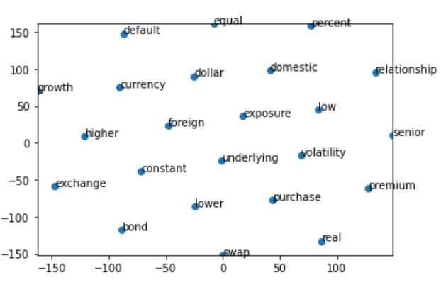
2D projection of top 0.1 %-tile similar words to “Currency” using TSNE

Slide 29
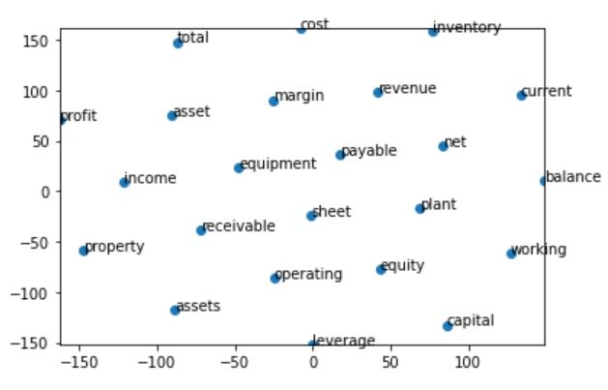
2D projection of top 0.1 %-tile similar words to “Assets” using TSNE

Slide 30
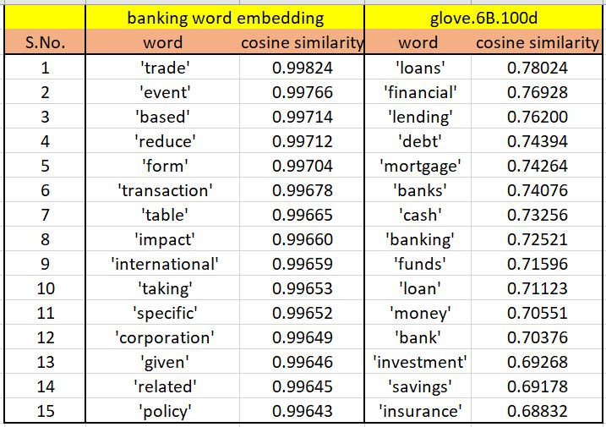
Comparing top 15 most similar words to “credit”

Slide 31
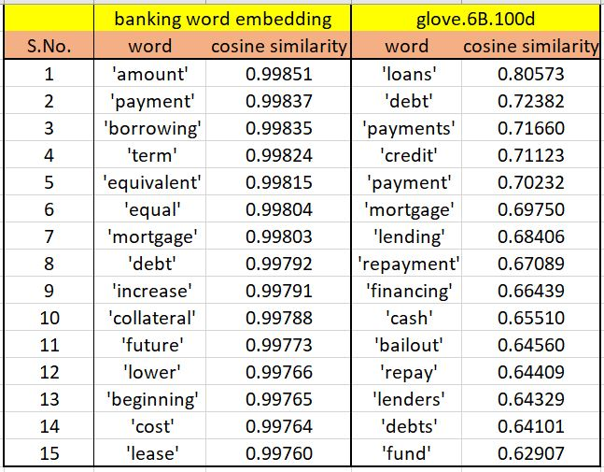
Comparing top 15 most similar words to “loan”

Slide 32
Acknowledgement
I would like to thank Arindam Chatterjee, for giving me this exciting opportunity, working on which I learnt a lot.
I want to thank Subhajit Pal and Arindam Pramanik for their constant support, guidance, quick trouble-shooting in situations where I could not find a way out, without which this project would not have to a fruition.

